Slide 1

Working with EPICS
-simple device integration-

Slide 2
Task: integrate a simple power supply using StreamDevice
The simulated device is a variable voltage power supply unit controller, offering a simple interface and message-based protocol.
The device listens on TCP/IP port <check the code ☺>.
It expects input commands following a known format followed by an End-Of-Line indicator.
To each known command, it returns a specific reply, also followed by an End-Of-Line indicator.
The End-Of-Line indicator in both directions is CR LF (CarriageReturn followed by LineFeed: \r\n). This is used to determine when a message ends and the next one begins.

Slide 3
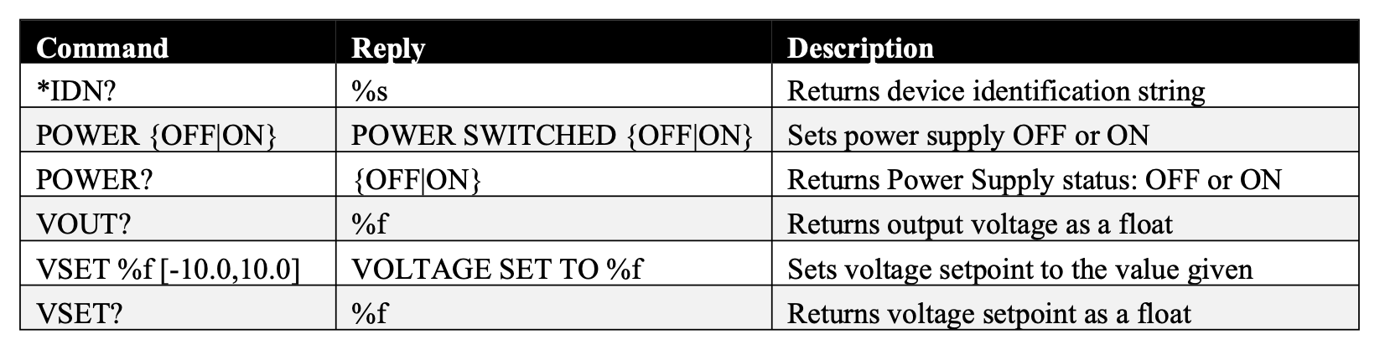
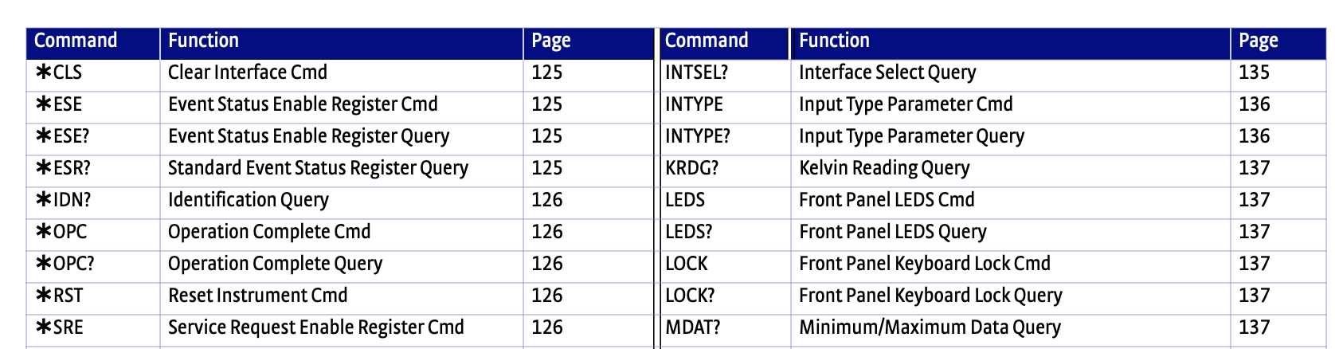
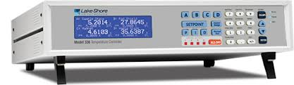
Task: integrate a simple power supply using StreamDevice
The following table displays the available commands the device simulator understands:
For a real-world reference, compare with a Lakeshore cryogenic controller (from Lakeshore-336 manual):

Slide 4
Task: integrate a simple power supply using StreamDevice
Start the VM:
The “training/streamdevice-introduction” folder contains an IOC setup that has been prepared to communicate with the simulated power supply.
Change to that directory and open a terminal. (two or three windows or tabs will be needed.)
Compile the ioc by typing make.
In one terminal window, start the simulator with:
“python PSU.py”
If you see a message reporting a port number, you are fine to go.

Slide 5
Task: integrate a simple power supply using StreamDevice
Starting the IOC:
Change to the directory “streamIoc/iocBoot/ioctestIoc”
It would be good to take a look at the directory structure
Start the IOC with the command ./st.cmd
Pay attention to the terminal output.
The IOC serves a number of records in addition to the PSU simulation.
Let us look at the startup script (st.cmd) to see the commands.
In another window, type “pvget epics-dev:IDN” and check the reply.
If you get a reply and no timeout, congratulations!
Next, let us examine the protocol file and the EPICS database.

Slide 6
Protocol File for the simulated power supply
# Stream protocol file for simulated PS
idn {
out "*IDN?";
in "%s";
}
power-rb {
out "POWER?";
in "%{OFF|ON}";
}
v-out {
out "VOUT?";
in "%f";
}
v-set-rb {
out "VSET?";
in "%f";
}
power-cm {
out "POWER %{OFF|ON}";
in "POWER SWITCHED %{OFF|ON}";
@init {power-rb;}
}
v-set-cm {
out "VSET %f";
in "VOLTAGE SET TO %f";
@init {v-set-rb;}
}

Slide 7
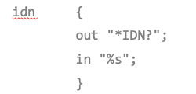
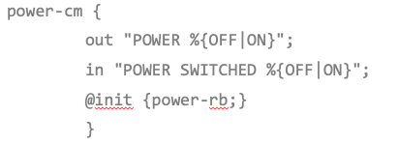
Example record definitions from the database
record(stringin, "$(user):IDN")
{
field(DESC, "Device identification")
field(DTYP, "stream")
field(INP, "@PSU.proto idn PSU0")
field(PINI, "YES")
}
v-set-record(bo, "$(user):POWER-CM")
{
field(DESC, "Power switch command")
field(DTYP, "stream")
field(OUT, "@PSU.proto power-cm PSU0")
field(ONAM, "ON")
field(ZNAM, "OFF")
field(FLNK, "$(user):POWER-RB")
}

Slide 8
Optional: Create a simple Phoebus OPI
Start the IOC, if not running.
Next, start Phoebus. Let us work interactively from here.
Task is to create an OPI with:
A button to switch on and off the power supply
A monitor widget (LED) to display the power supply status
A control widget (text, thumbwheel) to set the output voltage
A monitor widget to show the (actual) output voltage.
Notes:
The idea is to create a simple OPI that has the widgets to switch on the supply, set the output voltage and to monitor the output voltage.

Slide 9

Success!

